Slide 1
Ruby Training: Conditionals
Matthew Eakin, Manager
Managed Testing Practice
Sogeti, USA
Matthew.Eakin@us.sogeti.com

Slide 2
Agenda
Create the Conditionals.rb file in any existing project
What are Conditional Statements?
Types of Conditional Statements
if
else
Case
Exceptions
Rescuing code
Retry
Raise
Ensure

Slide 3
What are Conditional Statements?
A conditional statement is a way of telling the computer to conditionally execute some code: to execute it only if some condition is satisfied
The condition is an expression—if it evaluates to any value other than false or nil, then the condition is satisfied
Ruby has many types of conditional statements:
if – will execute if an expression is true
else – will execute if an expression is not true
Elsif

Slide 4
if
“if” expressions are used for conditional execution
Syntax:
if expression
<code>
end
In english: if the expression is true then execute <code>
Can also be written as:
if expression then <code> end
OR…
<code> if expression

Slide 5
else
“else” expressions are also used for conditional execution
Syntax:
if expression
<code>
else
<other code>
end
In english: if the expression is not true then execute <other code>

Slide 6
elsif
If you want to test more than one condition within a conditional, you can add one or more elsif clauses between an if and an else
Syntax:
if expression1
<code1>
elsif expression2
<code2>
else
<other code>
end
In english: if expression1 is true execute <code1>, otherwise, if expression2 is true then execute <code2>

Slide 7
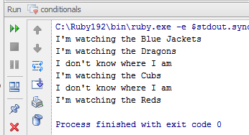
if..else..elsif code example
Write and Run this Code: Will get these results:
sogeti_cities = %w(Columbus Dayton Chicago Cincinnati)
sogeti_cities.each do |city|
if city.eql?("Columbus") then
puts "I'm watching the Blue Jackets"
elsif city.eql?("Dayton") then
puts "I'm watching the Dragons"
else
puts "I don't know where I am“
end
puts "I'm watching the Cubs" if city.eql?("Chicago")
if city.eql?("Cincinnati") then puts "I'm watching the Reds" end
end

Slide 8
unless
“unless” is the opposite of if: it executes code only if an associated expression evaluates to false or nil
elsif clauses are not allowed:
Syntax:
unless expression
<code>
end
In english: unless the expression is false then execute <code>
Can also be written as:
<code> unless expression

Slide 9
unless..else
“unless..else” expressions are also used for conditional execution
Syntax:
unless expression
<code>
else
<other code>
end
In english: if the expression is true then execute <other code>

Slide 10
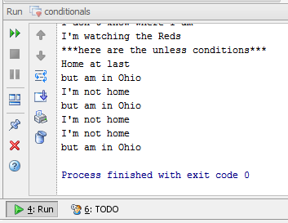
Unless..else code example
Write and Run this Code: Will get these results:
puts "***here are the unless conditions***"
sogeti_cities.each do |city|
unless city.eql?("Columbus") then
puts "I'm not home"
else
puts "Home at last"
end
puts “but am in Ohio" unless city.eql?("Chicago")
end

Slide 11
case
“case” is a multiway conditional
The case statement tests each of its when expressions in the order they are written until it finds one that evaluates to true
Syntax:
case expression
[when expression [,expression] [then]
<code>]…
[else
<code>]
end
In english: if when expression is true then execute <code>

Slide 12
?:
“?:” behaves much like an if statement, with ? replacing then and : replacing else
It provides a succinct way to express conditionals
Syntax:
expression ? <then code> : <else code>
In english:
if expression is true then execute <then code> else execute <else code>

Slide 13
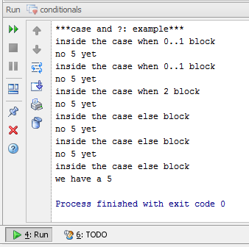
Case code example
Write and Run this Code: Will get these results:
puts "***case and ?: example***"
for n in 0..5 do
case n
when 0..1
puts "inside the case when 0..1 block"
when 2
puts "inside the case when 2 block"
else
puts "inside the case else block"
end
puts n.eql?(5) ? "we have a 5" : "no 5 yet"
end

Slide 14
What is an Exception
An exception occurs when the code is expecting one thing but something else happens
Some kind of error occurs
It is considered a bad coding practice to not properly handle exceptions
Typically programs stop if an exception occurs
. So exceptions are used to handle various type of errors which may occur during a program execution and take appropriate action instead of halting program completely.
Examples:
The code tries to open a file but the file does not exist
User enters text in a field but the code was expecting a number
User types in an incorrect userID/password combination

Slide 15
Exceptions
Ruby provides a way to handle exceptions gracefully
You can enclose the code that could raise an exception in a begin/end block and use rescue clauses to tell Ruby the types of exceptions we want to handle.
Syntax :
begin
<code>
rescue OneTypeOfException
< OneTypeOfException >
rescue AnotherTypeOfException
< AnotherTypeOfException > If an exception happens in the <code> block
else control is passed to the rescue..end block
< OtherExceptions >
ensure
# Always will be executed
end
This code is protected

Slide 16
Retry
Ruby allows you to retry a begin/end block if you receive a specific type of exception
Use the “retry” method to send control back to the beginning of the begin/end block
Syntax:
begin
# Exceptions raised by this code will
# be caught by the following rescue clause
rescue
# This block will capture all types of exceptions
retry # This will move control to the beginning of begin
end

Slide 17
Raise
You can use “raise” statement to raise an exception
There are four types of syntax that can be used to raise an exception:
“raise” – reraises the current exception (or a RuntimeError if there is no current exception). This is used in exception handlers that need to intercept an exception before passing it on
raise "Error Message" – creates a new RuntimeError exception, setting its message to the given string. This exception is then raised up the call stack
raise ExceptionType, "Error Message" – uses the first argument to create an exception and then sets the associated message to the second argument
raise ExceptionType, "Error Message" condition – similar to third form but you can add any conditional statement like unless to raise an exception

Slide 18
Ensure
Sometimes you might want to execute some code regardless if there is an exception
Ruby allows you to accomplish this through the use of the “ensure” method
Syntax:
begin
#.. process
#..raise exception
rescue
#.. handle error
ensure
#.. finally ensure execution
#.. This will always execute.
end

Slide 19
Warn
The “warn” function prints a warning message to standard error
The “warn” function does not raise an exception or cause the program to exit
Syntax:
<conditional> warn “<message>”
warn “<message>” <conditional>
Examples:
a, b, c = 1, 2, 3
if a > 1 then warn "a is greater than 1" end
warn "b is greater than 1" if b > 1

Slide 20
Abort
The “abort” function prints the specified error message to the standard output stream
then exits
Syntax:
<conditional> abort “<message>”
abort “<message>” <conditional>
Examples:
a, b, c = 1, 2, 3
if a > 1 then abort "a is greater than 1" end
abort "b is greater than 1" if b > 1

Slide 21
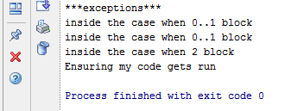
Exception code example
Add this Case code and Run: Will get these results:
puts "***exceptions***"
begin
for n in 0..5 do
case n
when 0..1
puts "inside the case when 0..1 block"
when 2
raise "inside the case when 2 block"
else
puts "Made it through!!!"
end
end
rescue Exception => e
puts e.message
ensure
puts "Ensuring my code gets run"
end

Slide 22
Thank you

